Slide 1

Integrating Implementation Science and Pragmatic Methods into Behavioral Medicine
Presented at Society of Behavioral Medicine Annual Meeting, Chicago, April 2026
Russell E. Glasgow, PhD
Research Professor Dept of Family Medicine
Director, Dissemination and Implementation Science Core
ACCORDS Center, University of Colorado School of Medicine
Thank you to the many friends, colleagues, mentors, mentees, community members and researchers who have taught me or with whom I discovered these lessons. Many are listed on the following slides, and the rest know who you are.

Slide 2
Overview
FIRST HALF: Curated conventional knowledge
Key issues and future directions in implementation science
Key issues and future directions in pragmatic research
SECOND HALF: Crystal ball gazing – future directions
Applying pragmatic implementation science in early-stage research
Examples, Resources, Challenges and Opportunities
No conflicts of interest.

Slide 3

Implementation Science:
Core Concepts, Frameworks, and Context

Slide 4
Key Issues in Implementation Science
Toward effective, adaptable, and sustainable solutions
Implementation Science
Use of Implementation Science (IS) frameworks:
Purpose‑driven selection and application
(Example of PRISM / RE‑AIM)
Context is Critical:
Strategies must align with multi‑level, dynamic contexts
Balancing Fidelity and Adaptation:
Preserve core functions; adapt forms
Sustainment and scale:
Design early for long‑term delivery and spread- and iterate

Slide 5
The study of methods (strategies) to promote the adoption and integration of evidence-based practices, interventions and policies into routine health care and public health settings to improve population health
Implementation Science
Alternatively, Implementation Science is:
Procedures
Programs
Products
Policies
Pills
Practices
Principles
Univ. Washington Imp Sci Resource Hub, 2022; Rinad Beidas
More technical definitions at: https://cancercontrol.cancer.gov/is/about and PAR 25-144

Slide 6
How Do I Select a D&I Framework?
(Amid substantial jargon and proliferation)
Frameworks
Over 150 frameworks! Good news is that there are many commonalities
Context is central:
Implementation unfolds in real‑world settings – maintaining a strong focus on external validity
Start with partners:
Engage at multiple levels; select a TMF that reflects their values, priorities, and perspectives
Specify key constructs and processes:
Focus on how implementation strategies are expected to produce effective outcomes
BOTTOM LINE:
Framework choice should be driven by purpose, context, and use
Tabak RG, et al. Bridging research and practice. Am J Prev Med. Sep 2012;43(3):337-350
Strifler et al. Scoping review on D&I TMFs. J Clin Epidemiol. 2018;100:92–102.

Slide 7
Types of D&I Frameworks: What is your purpose?
Frameworks
Explanatory or Determinant Consolidated Framework for Implementation Research (CFIR) Theoretical Domains Framework (TDF) Greenhalgh Implementation Processes Model Process Normalization Theory | Process/Evaluation Reach, Effectiveness, Adoption, Implementation, Maintenance (RE-AIM) Evidence-based Quality Improvement Replicating Effective Programs (REP/Enhanced REP) Getting to Outcomes
Nilsen, P. Implementation Science: Theory and application. Routledge: London, 2024

Slide 8

“Theories are like toothbrushes. Everyone has one and no one wants to use anyone else’s”
Various attributions. My favorite is Walter Mischel.

Slide 9
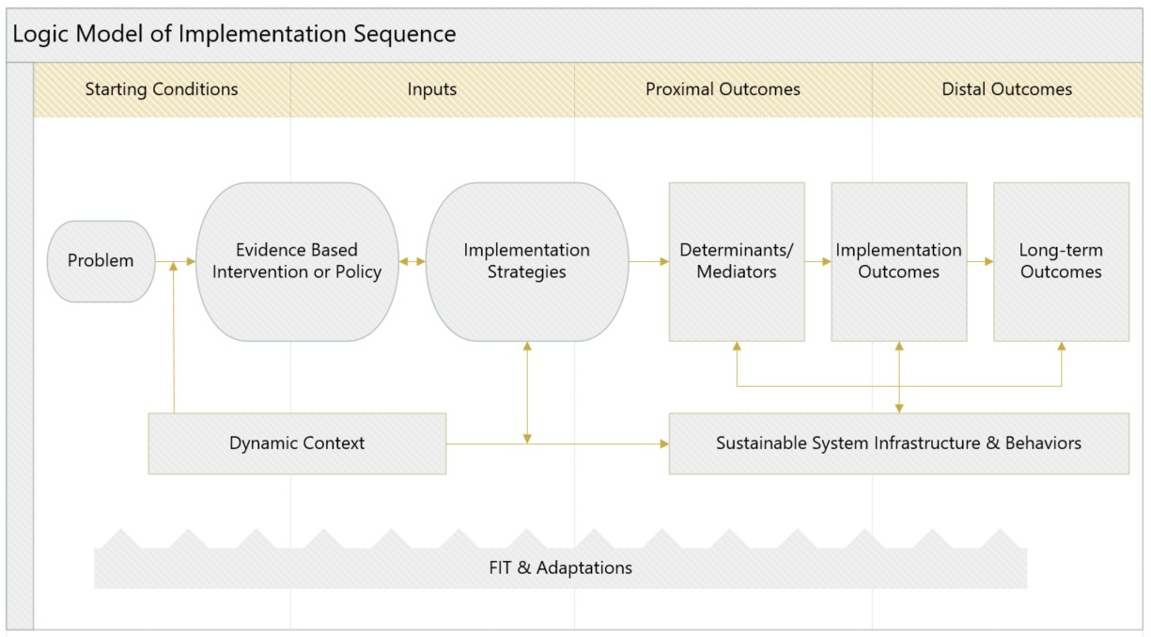
Example Implementation Science Logic Model
Fillable PDF Logic Model used in https://dissemination-implementation.org/tool/plan See Rabin, BA et al doi: 10.1017/cts.2025.10128.
Smith, J. D., Li, D. H., & Rafferty, M. R. (2020). The Implementation Research Logic Model. Implementation Science, 15(1), 84. https://doi.org/10.1186/s13012-020-01041-8

Slide 10
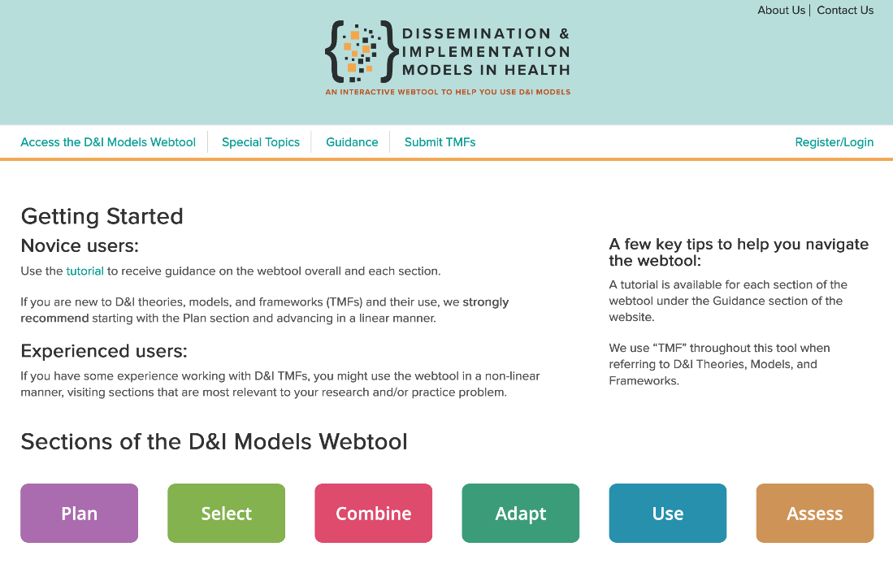
https://dissemination-implementation.org/ With funding from NCI and other NIH centers
Notes:
6 main sections – meant to be a one-stop-shop – currently over 110 TMFs included and 46 constructs based on close to a 1000 specific individual elements abstracted from the TMFs grouped to make them manageable and that allow for searching – this is the main CONTEXT FOR AND connection to the assessment instruments and TMFs within the webtool
MIGHT MENTON IN ONE SENTENCE THE SPECIAL TOPIC- COULD CIRCLE IT- ON HEALTH EQUITY... SOME ATTENDESS MIGHT BE INTERESTED IN
MIGHT MENTON GEM HAS CHANGED AND SIRC WAS LIMITED FOCUS AND PAY???

Slide 11

Context, Fidelity, and Adaptation: From Theory to Reality
If you don’t understand multi-level, dynamic context, you can’t fully explain results– or replication

Slide 12
Practical Robust Implementation and Sustainability Model (PRISM): which contains RE-AIM outcomes
Contextual Factors
Implementation and Sustainability Infrastructure
RE-AIM
Implementation
Outcomes
Characteristics
Perspectives on Intervention
Organizational
Leaders Managers
Patient
Family/ Caregiver
Organizational
Leaders Managers
Patient
Family/ Caregiver
Implementation Strategies
Reach Effectiveness Adoption Implementation Maintenance
(aligned with context and intervention)
Staff
Individual
Staff
Individual
External Environment
Feldstein, A. C., & Glasgow, R. E. (2008). Jt. Commission J Qual Patient Safety, 34(4), 228-243. doi.org/10.1016/S1553-7250(08)34030-6
Glasgow, RE et al. Global Implementation Research and Applications. 2024 https://doi.org/10.1007/s43477-024-00134-6.

Slide 13
Adaptation is not the opposite or enemy of fidelity
Adaptation
Traditional view: Adaptation = deviation = failure | Reframe Adaptation can improve fit to context Can strengthen (or weaken) outcomes Key is intentional + documented adaptation
What actually happens: Adaptation is inevitable Occurs at every stage Planning → Implementation → Sustainment
Ignoring adaptation is the real implementation failure.
Rabin, A.R., et al. Annu. Rev. Public Health 2025. 46:16.1–16.21. doi.org/10.1146/annurev-publhealth-071321-041652
Moore G, et al. (2020). The ADAPT Study guidance (v1.0). https://decipher.uk.net/portfolio/the-adaptstudy/.
Notes:
Guided adaptation are not ALWAYS controversial anymore…Maybe worth saying ‘sometimes controversial’? ☺
Russ- change ref

Slide 14
Design for FUNCTION – deliver through FORM
Function - Form
Fidelity to Core Functions: What the intervention must achieve Purpose or Goal Mechanism of change Critical to preserve fidelity to function | Practical Takeaway Protect functions Adapt forms Align with context
Flexibility in forms: How it is delivered locally Activities to accomplish function Flexible, context-specific forms
Standardize the ‘what & why’ – not the ‘how’.
Pérez Jolles, M., et al. (2019). Core Functions and Forms of Complex Health Interventions. JGIM,34(6):1032-1038. DOI: 10.1007/s11606-018-4818-7;
Pérez Jolles, M., et al. (2024). Aligning...complex interventions to local contexts. IJEH. 23(1):41. https://doi.org/10.1186/s12939-024-02130-6

Slide 15
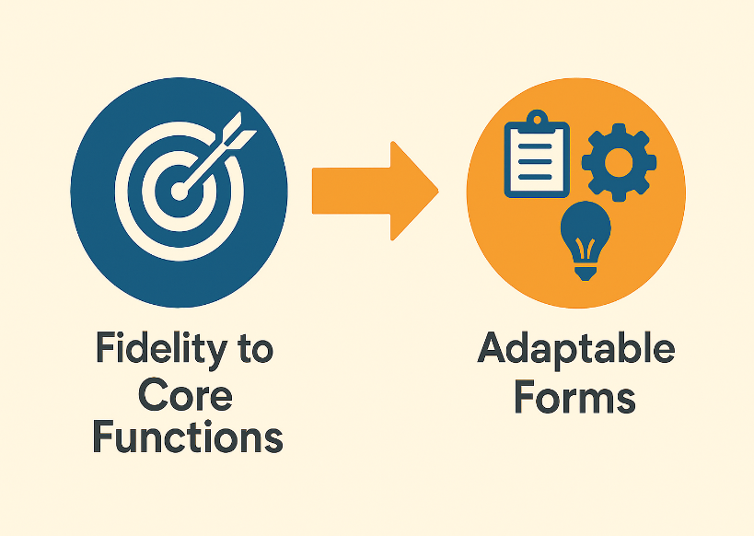
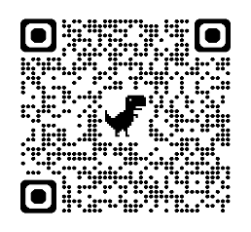
See examples and pragmatic Functions and Forms tools:
https://medschool.cuanschutz.edu/accords/CoresResources/dissemination-implementation-core/functions-forms

Slide 16

Pragmatic Research: Bridging Evidence and Real‑World Impact

Slide 17
Key Issues in Pragmatic Research
Increasing the pace, relevance and real-world application of science
Pragmatic Research
Framework guidance:
Using design frameworks to situate within the explanatory–pragmatic continuum(e.g., PRECIS‑2, 5 Rs)
Pragmatic assessment:
Selecting measures that are feasible, low burden, actionable, and meaningful to real‑world partners
Costing and feasibility:
Explicit attention to resources required, burden, and affordability for settings and participants
Applied example:
My Own Health Report as an illustration of pragmatic design, implementation, and evaluation
Glasgow, R. E., & Estabrooks, P. E. (2018). Pragmatic Applications of RE-AIM. Preventing chronic disease, 15, E02. https://doi.org/10.5888/pcd15.170271

Slide 18
A Big Tent of Terms (and ovals)
Terminology
Population Health (and Community) Services
Health Services Research
Implementation Science
Dissemination Research
Implementation Research
Pragmatic Research
QI
Quality Improvement Science
Adapted from Mitchell S, Chambers, D. https://doi.org/10.1200/JOP. 2017.024729.

Slide 19
The Need
Need for Pragmatic D&I Research
Most common reason evidence-based programs are not adopted…they are not seen as relevant or feasible by intended users
When we implement a tested intervention in everyday clinical practice, we usually see a “voltage drop”…a dramatic decrease in effectiveness
Traditional NIH ‘Stage Model’ of Research has limited the success and speed of translation
“If we want more evidence-based practice, we need more practice-based evidence.”
Green LW
Am J Pub Health 2006
Chambers, D. A., et al. (2013). The dynamic sustainability framework. Implement Sci, 8(1), 117. https://doi.org/10.1186/1748-5908-8-117
Kessler, R., & Glasgow, R. E. (2011). A Proposal to Speed Translation of Healthcare Research. Amer J Prev Med, 40(6), 637-644. https://doi.org/10.1016/j.amepre.2011.02.023

Slide 20
Generalizability
Explanatory vs. Pragmatic Trials
Explanatory (Efficacy or Effectiveness) trial: Specialized experiment in a homogeneous setting(s) and population in controlled conditions Emphasizes internal validity | Pragmatic Clinical Trial (PCT): Real-world test in a real-world population Designs emphasize Generalizability: Participation or reach Adoption by diverse settings Ease of Implementation Maintenance or Sustainment
Pragmatic does not mean less rigorous!!!
NIH Health Care Systems Research Collaboratory. Rethinking Clinical Trials: A Living Textbook of Pragmatic Clinical Trials. https://rethinkingclinicaltrials.org/
Glasgow, R.E. (2013). What does it mean to be pragmatic? Health Educ Behav, June;40(3):257-65. https://doi.org/10.1177/1090198113486805
Notes:
Louden or Treework ref

Slide 21
PCTs: Fewer Exclusions Allow for a Broader Subset of Settings, Staff, and Participants
Traditional RCTs
Pragmatic Trials (PCTs)
Eligible population
Eligible population
Exclusions, non-response, etc.
Exclusions, non-response, etc.
Efficacy, among a defined subset
Effectiveness, in a broad subset
Figure provided by Gloria Coronado, PhD

Slide 22
Continuum
The RCT-PCT Continuum
PCTs are not an abandonment of the scientific methods that have led to countless breakthroughs.
They don’t take away from or diminish the importance of traditional RCTs – we just need a balance.
No study is completely explanatory or pragmatic. RCTs and PCTs exist on a continuum.
Explanatory Trial
Can an intervention work under ideal conditions?
Pragmatic Trial
Does an intervention work under usual conditions?
Loudon, K., et al.(2015). The PRECIS-2 tool: designing trials. BMJ, 350 (May08 1) https://doi.org/10.1136/bmj.h2147

Slide 23
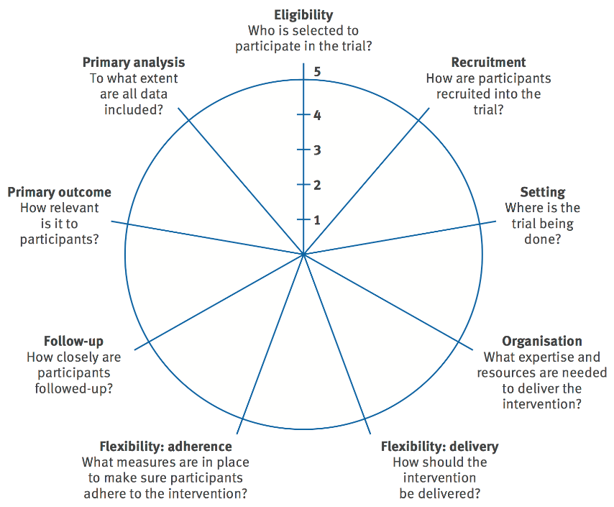
How pragmatic is your study on these 9 dimensions?
Not all or none- what dimensions are more and less pragmatic
PRECIS
Pragmatic Explanatory Continuum Indicator Summary
PRECIS- 2…and PRECIS- 2 PS updates
Norton WE, Loudon K, Chambers DA, Zwarenstein M. Designing provider-focused implementation trials: the PRECIS-2-PS Implementation Sci. 2021 Dec;16(1):1-1. doi.org/10.1186/s13012-020-01075-y

Slide 24

Designing for Pragmatism: Tools, Assessments, and Costs

Slide 25
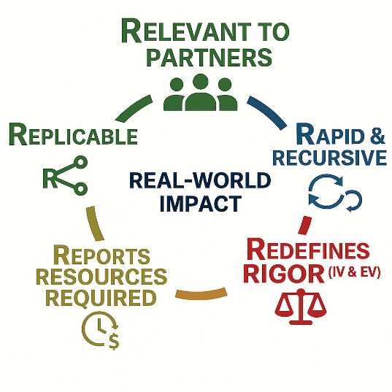
The 5 R's Model to Assess and Enhance Pragmatism, Implementation Science, and Likelihood of Translation
Assessment
Design for and Assess the Extent to which Research is:
Peek, C.J., et al. (2014). The 5 Rs: An emerging bold. Annals of Family Medicine, 12(5), 447-55. https://doi.org/10.1370/afm.1688
deGruy, F.V., et al. (2015). A plan for useful and timely family medicine and primary care research. Family Medicine, 47(8), 636-42.

Slide 26
Costs (Resources Required), Adoption, and Maintenance
Cost
“More is better” mindset:
Sole focus maximizing an effectiveness outcome (e.g., A1c) often increases complexity and cost
Limited real‑world feasibility:
Many evidence‑based interventions are impractical or unaffordable outside research settings
Adoption and maintenance hinge on cost:
Cost is often the first question adopters ask and a key driver of sustainment
Cronin J, Gritz M, Eisman A, et al. A Costing Guidebook for Implementation Scientists. Retrieved August 23, 2023. from https://bit.ly/cost-guidebook
Eisman AB, et al. Making Implementation Costing More Accessible: Implement Res Pract. 2026 Apr 6. doi: 10.1177/26334895261438501

Slide 27
Initial study of My Own Health Report ala 5 Rs
Digital health risk appraisal and goal setting tool
MOHR 1/2
Relevant: Addresses multiple health risks endorsed as important by patients, primary care, and epidemiologic evidence using very brief pragmatic questions
Rapid: Entire project completed involving over 3500 patients in 18 diverse clinics in a multi-site trial within 18 months from proposal review to follow-up. Individual sites did rapid experiments to enhance recruitment and implementation
Redefines Rigor: Balanced internal and external validity
External validity: Diverse patients and clinics and assessed outcomes across 10 risk factors
Internal Validity: Randomized PCT using validated pragmatic screening measures
Glasgow, R.E., et al. (2014). Conducting rapid, relevant, research. Am J Prev Med, August;47(2):212-9.
Krist, A. H., et al. (2016). The impact of behavioral and mental health risk assessments on goal setting in primary care. Transl Behav Med, 6(2), 212-219. https://doi.org/10.1007/s13142-015-0384-2
Notes:
Add orgins SBM

Slide 28
My Own Health Report a la 5 Rs (cont.)
MOHR 2/2
Resources Required:
Entire multi-center project completed in one year of funding by end of year via NCI funding supplements
Replicable:
All centers had similar intervention effects; was considerable variability in reach across sites
First of 3 studies on MOHR that have found positive short-term improvements in self-efficacy, goal setting and improvements across multiple behaviors
*We are continuing work on MOHR in new NCI R01 (Huebschmann, Glasgow MPIs) with full integration into the EPIC EHR

Slide 29

Patient-Reported Measures Of Psychosocial Issues And Health Behavior Should Be Added To Electronic Health Records
“The Good Old Days”
Health Affairs > Vol. 31, No. 3: Variety Issue
ANALYSIS & COMMENTARY
Russell E. Glasgow, Robert M. Kaplan, Judith K. Ockene, Edwin B. Fisher, and Karen M. Emmons
PUBLISHED: MARCH 2012 | https://doi.org/10.1377/hlthaff.2010.129
Related SBM Policy Statement: Glasgow, R., & Emmons, K. M. (2011). Translational Behavioral Medicine, 1(1), 108-109. https://doi.org/10.1007/s13142-011-0017-3

Slide 30
Pragmatic Assessment
Assessment
Relevant, rapid, and rigorous:
On issues desired by decision makers, are brief and can be widely used, quickly analyzed, and are actionable
As opposed to psychometrically superb but not usable:
‘Beautiful measures’ (often extremely long, burdensome surveys, inequitable completion) that no real-world setting could use
The future for pragmatic assessment is bright- with more rapid qualitative assessment, use of AI for coding of observations, computer adaptive testing to dramatically shorten surveys
Riley W.T., et al. Rapid, responsive, relevant (R3) research. Clin Transl Med. 2013 May 10;2(1):10. doi: 10.1186/2001-1326-2-10.
Weiner, B. J., et al. (2017). Psychometric assessment of three newly developed... Impl Sc, 12(1). https://doi.org/10.1186/s13012-017-0635-3
Notes:
I love this slide! And I love thew term beautiful measures. Made some formatting edits.
This resulted in ‘beautiful measures’ (albeit extremely long, burdensome) that no one could use – also led to inequitable completion by those more resourced, better off not not by participants with competing issues????

Slide 31
Pragmatic Measures- ala Glasgow and Riley (2013)
Assessment
Required Criteria Important to key partners Brief, burden is low to moderate Broadly applicable, has norms to interpret Sensitive to change Actionable (not in original list) | Additional Criteria Low probability of harm Addresses public health or quality of care goal(s) Related to theory or model “Maps” to “gold standard” metric or measure
Glasgow, R.E. and Riley, W.T. (2013) WT. Pragmatic measures… Am J Prev Med 2013;45(2):237–243). doi: 10.1016/j.amepre.2013.03.010. https://dissemination-implementation.org
Glasgow, RE & Riley, WT. Pragmatic measures… Am J Prev Med 2013; 45(2): 237–243.

Slide 32
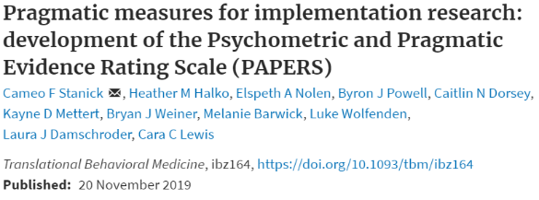
Assessment
Subjective (partner facing)
Acceptable
Offers relative advantage over existing methods
Completed with ease
Appropriate
Fits organizational activities
Informs clinical or organizational decision making
Objective (from the literature)
Low cost
Uses accessible language
Low assessor burden (training) scoring/interpretation)
Brief
Notes:
We also created pragmatic measures rating criteria because we believe that measures should not only be sound with respect to their psychometric strength but they could be a valuable tool for our stakeholders to inform their implementation work. To ensure measures are valued by stakeholders, we learned that they need to be acceptable, offer relative advantage over existing methods… These are all features that the stakeholder must rate. In addition, we learned there are objective measure criteria including cost, language, assessor burden, and length.

Slide 33

Applying Pragmatic Implementation Science Earlier – and Faster

Slide 34
Applying Pragmatic IS approaches early and often
Application
For more than late‑stage research:
Applying IS principles in early‑stage studies, not only T3–T4 research
Where things go wrong:
Using tools to anticipate, track, address, and transparently report implementation challenges and results (including bad ones)
Need for speed:
Moving more rapidly while maintaining rigor
Leppin A.L., et al. Situating Dissemination and implementation within and across...(2019) Jour Clin Transl Sci 4: 152-158. doi:10.1017/cts.2019.392

Slide 35
Conventional Wisdom is WRONG about sequential study of efficacy, then effectiveness, then implementation
Application
Because:
This sequence results in unnecessary delays and contributes to ’17-year gap’
Different types of evidence – not just effectiveness (reach, feasibility, representativeness)- are needed early
Including pragmatic and IS issues early is more likely to result in implementable, generalizable, and sustainable interventions
Earlier application of IS approaches can and has been done successfully
Brownson RC et al. Revisiting concepts of evidence . Impl Sci 17, 26 (2022). https://doi.org/10.1186/s13012-022-01201-y
Glasgow, R.E. What types of evidence are most needed? (2008). Ann Behav Med, 35:19-25. DOI 10.1007/s12160-007-9008-5

Slide 36
Concept or Methods Issue | Earlier Stage Efficacy and Effectiveness Research | Later Stage Hybrid or Implementation Research
Multi-Level Participation rate and Generalization | Consider if most settings have resources needed Co-design with implementation setting partners | Systematically include diverse settings Assess and analyze contextual factors related to outcomes
Multi-level representativeness across Participants and Outcomes | Qualitatively review if are differences on processes or outcomes across settings, staff, or patients | A priori specify and analyze key characteristics at multiple levels related to implementation and effectiveness
Determinants of Effectiveness | Note and report adaptations made Include brief probes on feasibility and usability | Systematically code and consider guiding adaptations made Systematically assess multiple implementation outcomes
All issues- CONSIDER the impact of decisions on generalization and replication | Conduct ‘Thought Exercises’ Be transparent in reporting exclusions and adaptations | Use D&I frameworks to identify and analyze implementation processes and their relationship to outcomes

Slide 37
Feasibly Including Pragmatic IS Approaches in Pilot or Early-Stage Research
Application
How Can You…
Q: Assess context?
A: Include at least 2 settings; interviews or brief survey; process map
Q: Consider the range of adaptations needed/allowed?
A: Discuss Functions-Forms with your implementation partners
Q: Do intervention time and ‘back of envelope’ cost estimates?
A: Ask your implementation partners is this feasible for most settings?
Q: Assess feasibility and sustainment potential?
A: Ask is something like this possible to be implemented- and sustained?

Slide 38

Where Things Go Wrong: Understanding Loss of Generalizable Impact

Slide 39
When Things Go Wrong
When, Where and Why Things Go Wrong
Loss of Generalizable Impact Results From:
  1. Suboptimal participation rates at multiple levels - Systems, practices, staff, patients
  2. Limited representativeness at all levels
    Who participates ≠ who needs it
  3. Reduced effectiveness
    Lower program intensity
    Poor fidelity
    Insufficient tailoring
    Low/declining engagement
  These problems compound.
  Each alone reduces generalizable (replicable) impact – combined they sharply diminish population-level benefit
Work in progress- manuscript revision in process; building off and expanding on:
Glasgow R.E., Huebschmann, A.G., Brownson, R.C. Am J Prev Med. 2018;55:422 https://doi.org/10.1016/j.amepre.2018.04.044

Slide 40
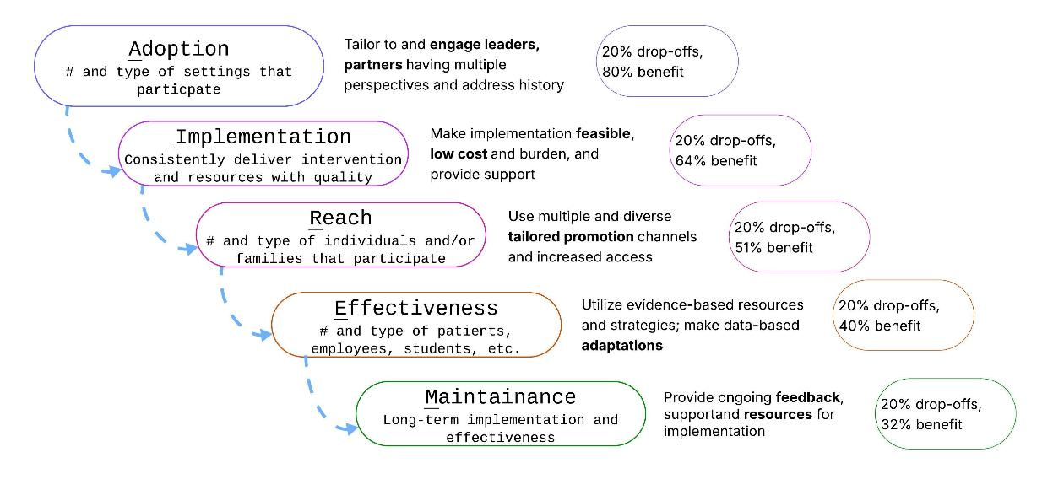
Cascade Effect
Where Things Go Wrong – the RE-AIM Cascade
Anticipate:
Mitigate:
Track:
Report:
Perez Jolles, M., Fort, M. P., & Glasgow, R. E. (2024). Aligning the Planning, Development, and Implementation of Complex Interventions to Local Contexts. International Journal for Equity in Health. 23:41 https://doi.org/10.1186/s12939-024-02130-6

Slide 41
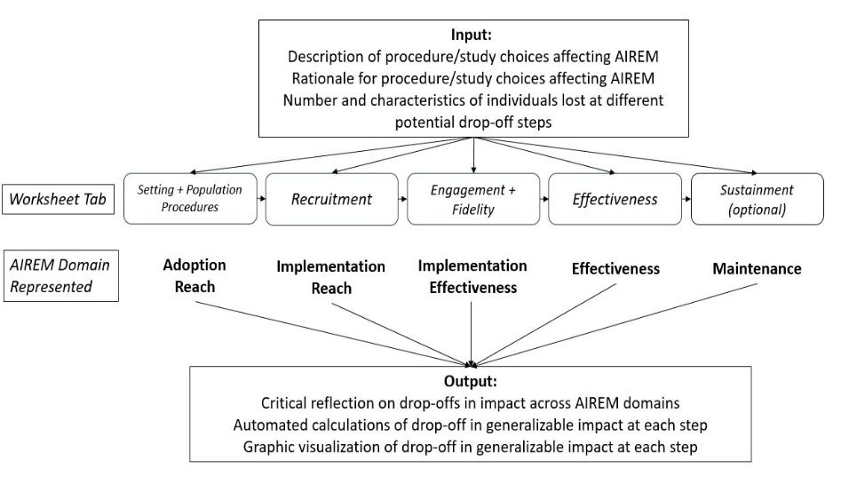
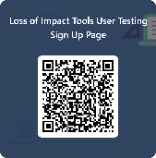
PRePARE Tool
Tools to Plan For, Track, and Report on Generalizable Impact
LOGIC-PRePaRE Calculator
Longitudinal use for:
Planning:
Tracking;
Adapting:
Transparently Reporting

Slide 42

Rapid, Iterative Learning ala
RE-AIM, PRISM, and iPRISM

Slide 43
The Need for Speed: Moving Rapidly and Iteratively
Iterative PRISM / RE-AIM
Expect early suboptimal performance:
Most interventions initially do not work as planned
Monitor what matters – repeatedly:
Track short‑term, multi‑dimensional impact (e.g., RE‑AIM outcomes) with attention to equity and population impact
Guide adaptations:
Adapt using theory, data, and partner priorities – fail fast and improve, not fail slowly
Record Adaptations:
Transparently report them!
Glasgow et al. RE-AIM Planning and Evaluation Framework: Adapting to New Science and Practice with a 20-Year Review. Front Public Health. 2019;7:64.
Maw, A.M., et al. Implementation Science Communications, 3(1). https://doi.org/10.1186/s43058-022-00334-x

Slide 44
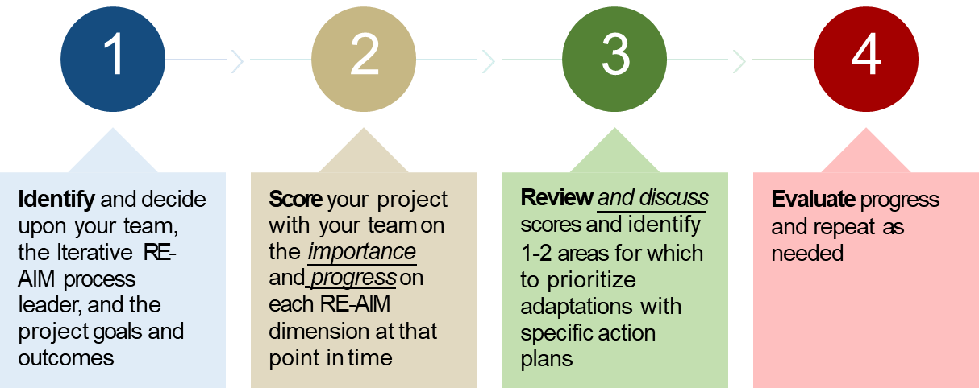
How do you use iterative RE-AIM?
Iterative PRISM / RE-AIM
Glasgow RE, Battaglia C et al. Use of the RE-AIM framework to guide iterative adaptations: Applications, lessons learned, and future directions. Front Health Serv. 2022;2:959565. doi:10.3389/frhs.2022.959565

Slide 45
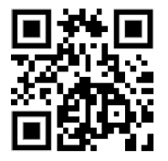
iPRISM Webtool- to rapidly assess and apply PRISM
Iterative PRISM / RE-AIM
Simplify implementation science - using PRISM
  For diverse researchers and implementation teams
  Support rapid learning health systems
Guide and prompt users to iteratively
  Assess context
  Align project with context
  Assess progress on key PRISM (RE-AIM) outcomes
  Develop feasible and impactful strategies/adaptations
  Create action plans
Try it out!!
IF YOU DO...for program name, please include ‘TEST’
prismtool.org
Trinkley K.E., et al. The iPRISM webtool. Impl Sci Comm (2023) 4:116 https://doi.org/10.1186/s43058-023-00494-4.
Maw, A. M, et al. Using Iterative RE-AIM to enhance hospitalist adoption. Impl Sci Comm, 3(1). https://doi.org/10.1186/s43058-022-00334-x

Slide 46

Thank You!
In summary, please consider:
Balancing Fidelity to Functions and Adaptation to Context
Thinking Broadly about Evidence
Applying Implementation Science Concepts and Methods Earlier
Using IS Tools to Make Your Research More Rapid, Relevant, and Generalizable
Russell E. Glasgow, PhD
Research Professor Dept of Family Medicine
Director, Dissemination and Implementation Science Core
ACCORDS Center, University of Colorado School of Medicine
russell.glasgow@cuanschutz.edu

Slide 47

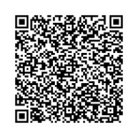

Pragmatic Research:
Methods, Tools, and Technology for Rapidly Changing Contexts
May 20 - 21, 2026
Learn More and Register COPRHCon.com

Slide 48

Rapid, Rigorous, Patient-centered Program (R2P2)
MPIs: Dan Matlock & Russ Glasgow
Program Managers: Kate Noonan and Bryan Ford
Key funding from the Anschutz Acceleration Initiative & support from ACCORDS

Slide 49

Summary
Context Matters and it changes – You need to adapt to and align with it
Fidelity and Adaptations are not opposites – You will almost always need to adapt to sustain (or scale-out)
Cost and burden are key, understudied issues in the front of almost all decision makers’ minds – You need to at least consider, if not track and report it.
Decisions you make about inclusions/exclusions, feasibility, tailoring, engagement at multiple levels have cumulative impact
Don’t wait until later stage research to apply IS concepts and methods
Notes:
BF: consider making all of there a statement and then a “you need” call to action like the first few. Makes the message hit harder and stick.

Slide 50
Importance of Different and Multiple Types of Evidence
More than the RCT
Biomarker and disease outcomes, but also
Quality of life and ‘measures that matter’- participant priorities
Implementation and intermediate outcomes
Behavioral observations- increasingly possible to collect and analyze
Multi-level- individual, ‘delivery agent’, setting, system, policy
*Long term maintenance (sustainment)
*Replication
Brownson RC et al. Revisiting concepts of evidence in implementation science. Implementation Sci 17, 26 (2022). https://doi.org/10.1186/s13012-022-01201-y
Glasgow RE. What types of evidence are most needed to advance behavioral medicine? Ann. Behav. Med. (2008) 35:19–25. DOI 10.1007/s12160-007-9008-5
Notes:
As I am going through these slides, the salient messages are building – maybe have a slide at the beginning and/or end that just lists the salient messages/ahas?
This may just be more of my own reflection, but sharing in case helpful - I continue to internally wonder what people really mean when they use the terms scale out, replication/replicability, generalizability and I see you have used replication and generalizability in this talk so far. Are the differences in meaning important for the audience to understand? If no, then no need to do anything different, but if yes then maybe articulate.

Slide 51
R2P2 Specific Aims
Design a host of R2P2 tools and resources to improve capacity to conduct rapid and rigorous research on patient-centered care.
Rapidly and rigorously Implement & Test interventions in multiple real-world settings and for many clinical issues (from primary prevention to palliative care) using pragmatic research and the tools and guides above.
Rapidly and rigorously Disseminate and Sustain project and delivery and outcomes.
Initial proof of ability to support and conduct rapid, rigorous pragmatic research- initially with 4 mid sized projects, ranging from primary prevention to end of life
Note- with generous support from and collaboration with ACCORDS Cores, staff, admin, and numerous investigators
Notes:
Note- I changed aim 1 it caught my attention!! ☺
OK, disseminate is another word to throw in the mix with generalizability, scalability etc. Disseminate implies something is generalizable, replicable and scalable. I think I am just going on on a little tangent with these notes about this bucket of words – I don’t think other people get hung up on the intended sentiment of them like I do.

Slide 52
Key Role of Implementation Strategies in Pragmatic D&I Science
Intervention
Implementation Strategies
Outcomes
Implementation Outcomes
Service Outcomes
Client Outcomes
Evidence- Based Practice
(“the thing”)
Systems | Environment Organizational Group/Learning Supervision
Individual Providers/Consumers
(the ‘how’)
Feasibility Fidelity Penetration Acceptability Sustainability Uptake
Costs
Efficiency Safety Effectiveness Equity Patient-
centeredness
Timeliness
Satisfaction Function Symptomatology
Proctor E. K., et al., Adm Policy Ment Health. 2009 Jan; 36(1)
Proctor, E. K., Powell, B. J., & McMillen, J. C. (2013). Implementation strategies: recommendations for specifying and reporting. Implementation Science, 8(1), 139. https://doi.org/10.1186/1748-5908-8-139
Notes:
Perhaps because I ‘grew up’ with RE-AIM, I always modify this figure from Proctor. I see you have some too. I think all the descriptors/examples under each header are distracting so usually simplify those and remove ’strategies’ from the intervention header.
Russ –change IS categories to Walz????

Slide 53
PRECIS
PRECIS: One Dominant Framework for Pragmatic Research
Nuances and Challenges
Especially useful in planning
And valuable longitudinally for examining role differences and informing literature review
Goal: be strategically pragmatic where it matters to all invested partners
NOT to be maximally pragmatic on all dimensions
Threatening to some
Forces reconsideration of what “pragmatic” really means (the “emperor has no clothes” moment)
Opportunity ahead
Advance work on multi‑level application and pragmatism of interventions and implementation strategies
Notes:
Great slide! Perhaps emphasize that it is a good way to push ourselves and see if in areas where we are less pragmatic, should we continue to be exploratory or can we make changes…
Mention that it has been also used to compare studies in a topic area??? Show a completed visual for a real world study? Like you did it with 5Rs later?

Slide 54
We over-emphasized fidelity – and under-emphasized engagement (my experience)
Fidelity
Early assumption: Rigid protocols = better science Standardization = fidelity | Core Insight Fidelity ≠ following the manual Fidelity = preserving core functions Over-specification → disengagement
COMMIT trial reality: 200+ page protocol binders Expected to implement 'as written’ → Poor engagement
If partners can’t use it, fidelity doesn’t matter.
COMMIT ref
Notes:
Great example!!
How about other studies just briefly that speak to patient adherence to many session interventions???

Slide 55
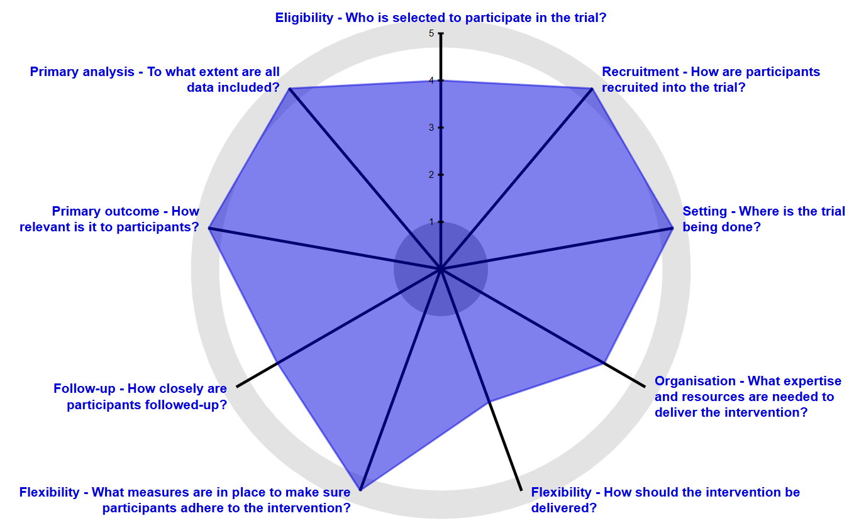
Example PRECIS-2 PS
Completed - More Pragmatic

Slide 56
Bottom Line: World According to Russ
Multi-level, Realist, Systems Science Approach to Pragmatic Research
Pragmatic Implementation Science North Star - Key issues to address:
  What Intervention Components delivered via what Implementation Strategies
  Are most effective for producing what Outcomes in what Settings
  Via what Mechanisms in what Contexts
  For what Populations at what Time points
  What does it Cost and How does it come about
Pawlson, R. The Science of evaluation: A realist manifesto. Sage: New York, 2013
Glasgow, R.E., Ford, B.S., Bradley, C.J. (2023). Transl Behav Med. 2023 Dec 30 doi: 10.1093/tbm/ibad078.
Notes:
Ohhh, I like how you say ‘intervention components’ AND ‘implementation strategies’ in one line!! I think is helps the audience understand these complex and important issues
Ah, you mentioned mechanism!!! I really struggle with how many ppl identify ‘mechanisms’ - maybe because I think of mechanisms in a more traditional sense of cause and effect and most often mechanisms are subjectively identified in our field – a place where AI can help in my opinion ☺
For what populations (and which NOT) at what time points…
I like this summary slide AND still like the idea of listing out the key messages/ahas in the talk verbatim – using the headers on the prior slides

Slide 57
Different Perspectives: What is a Pragmatic Trial?
PRECIS family of characteristics/dimensions
5 Rs model
Decentralized Pragmatic Trials: Conducted across multiple sites or locations, often leveraging electronic health records and decentralized coordination to reflect diverse patient populations and settings. (Ford I, Norrie J. N Engl J Med. 2016;375(5):454-63. doi:10.1056/NEJMra1510059)
Comparative Effectiveness Research (PCORI)
Platform Pragmatic Trials (international collaborations)
Others?
For discussion now (briefly) and at end of talk

