Slide 1
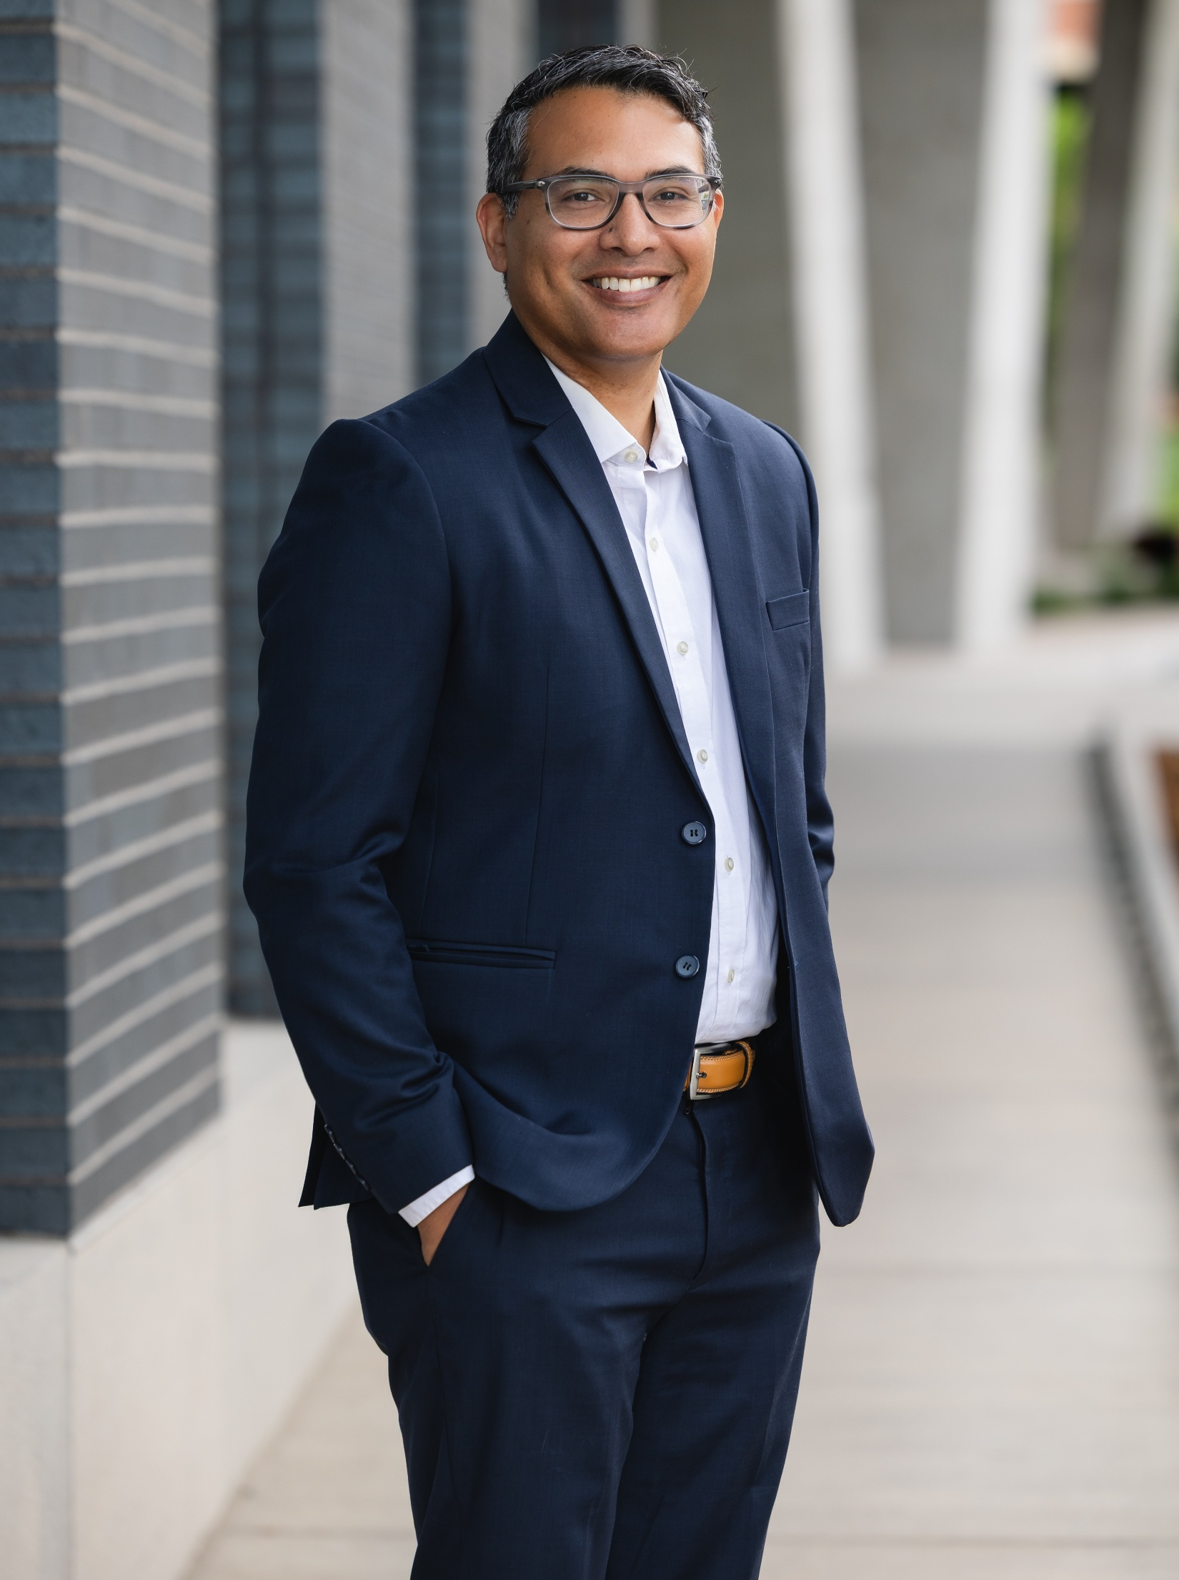
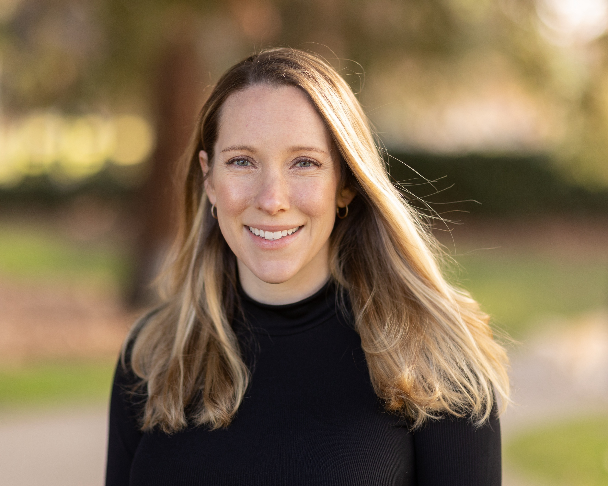
ACCORDS Highlights
Use of Secondary Data to Advance Health Outcomes
Tom Valley, MD, MSc
Caitlin Bell, MD

Slide 2
Use of Secondary Data to Advance Health Outcomes
Tom Valley, MD, MSc, ATSF
Director
Secondary Data Resource Core
ACCORDS
Notes:
I want to talk about what becomes possible when more people on this campus have access to secondary data to answer questions they care about. My focus today is on administrative claims. But I want to begin with the experience that made this kind of research feel possible to me.

Slide 3
My first fellowship research meeting (2014)
Patterns of intermediate care use
Effect of ICU admission on mortality for patients with pneumonia
Volume-outcome effects in critical care
Notes:
My first fellowship research meeting was with my primary mentor Colin Cooke, who is a critical care physician, in the hospital cafeteria at the University of Michigan. At the time, Colin roughly sketched out three possible studies for me.
All three used claims data. All three were things I could start working on right away.
And as we grow our secondary data resource core here at ACCORDS, I often come back to that meeting when I think about what we are trying to build here. Within that one conversation, there were several tangible paths that I could take as I started into research.
That is a powerful experience at the beginning of a career. Research questions can feel interesting but distant until someone helps you see how you might actually study it. The data there at your fingertips give that conversation somewhere to go. A mentor helps turn the possibility into a next step.
The lesson I take from that meeting is that the environment around an investigator (no matter how junior or senior) changes which questions feel possible to answer. When the data and the expertise are within reach, a conversation about research can become a conversation about getting started.
Our goal, for the Secondary Data Resource Core, is for more people at CU to have similar experiences. A fellow with an observation from the ICU. A clinician who keeps seeing the same gap in care. A researcher with a question that reaches beyond one clinic or one health system. We want them to be able to bring that question to a conversation and leave with a path forward.
Now, I want to make sure that most of this session is available to highlight the fantastic work by Dr. Bell and her team, but I also want to take advantage of this opportunity to tell you a little more about the Secondary Data Resource Core and our plans for the future.

Slide 4
Who benefits from ICU admission?
Older adults with Medicare hospitalized with pneumonia
1.1 million patients at 2,988 hospitals from 2010-2012
Unadjusted and adjusted outcomes look worse among ICU patients
An instrumental variable analysis demonstrates 6 percentage point improvement in survival when the admission decision was discretionary
Valley TS et al. JAMA. 2015;314:1272–1279.
Notes:
From that first meeting with Colin, we started working on the second question from the prior slide – what is the empirical benefit of ICU care. While for a long time there was a strong assumption of the benefits of ICU care, no one had ever actually observed it, as you can imagine, a randomized trial of ICU care is difficult to pull off, ethically and logistically.
This was also a question that certainly resonated with me at the time, when I was a PCCM fellow.
In our study that we started in 2014, we used Medicare data to study older adults hospitalized with pneumonia across nearly 3,000 hospitals. Claims made it possible to examine that question at a scale far beyond one institution.
There is also a useful methodological lesson here. Patients admitted to the ICU had worse outcomes in the unadjusted and adjusted comparisons. Of course, the decision to send someone to the ICU depends on how sick they are. And so you would expect sicker patients to end up in an ICU.
We used an instrumental-variable approach based on differential distance to hospitals with higher ICU use. The analysis suggested lower mortality among patients whose ICU admission appeared discretionary. That estimate depends on the instrument’s assumptions and applies to that particular group.
The point for today is the combination: an important clinical uncertainty, data broad enough to study it, and a design that takes the comparison seriously. That combination is what makes secondary data research valuable.

Slide 5



Mission – Secondary Data Resource Core
Shared data
Increase access and secure computing for investigator use across projects
Shared expertise
Analysts and methodologists
who know data and limitations
Shared community
Mentorship and collaboration
that grow a base of investigators
Notes:
When I think about the kind of work we were able to do at Michigan, I also think about the environment around the investigators that made it possible.
Before I left Michigan, I directed the Institute for Healthcare Policy and Innovation’s Data and Methods Hub, which brought together access to data with analytic support and training. That model offers us a path forward here at CU.
So what I’m really saying is that acquiring a dataset is one part of the work. We also need people who understand its quirks, colleagues who can help with study design, and opportunities for investigators to learn from each other.
Imagine how much easier a first project becomes when someone has already worked through the enrollment files, knows the codebook, documented important limitations, developed a useful definition, or already has some data cleaning code in place. Each team still has to think carefully. But each team can build on what the previous team learned.
That is the kind of research community we want to grow here: one where curiosity has somewhere to go and where experience accumulates across studies.

Slide 6

A wider view of care
Follow care across settings
Study variation across clinicians and hospitals
Examine patterns over time
Notes:
Secondary data are collected for another purpose; we then use those data to answer a new research question. Administrative claims arise largely from billing and insurance administration.
That origin creates a useful perspective. We can often see covered care across several settings, including care outside the health system where a patient started. The exact view depends on the dataset and insurance coverage.
For this campus, the opportunity is to bring our clinical questions to that wider view. A pattern we notice locally might be widespread. A transition that seems straightforward inside the hospital may look very different over the following months.

Slide 7
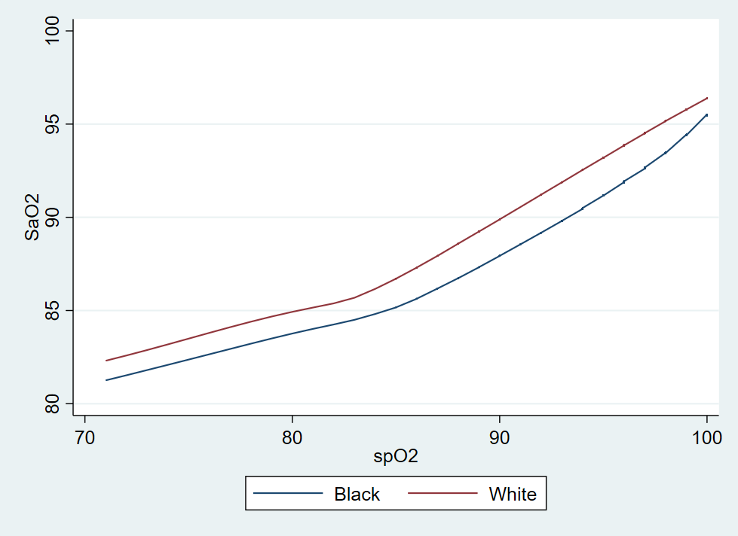
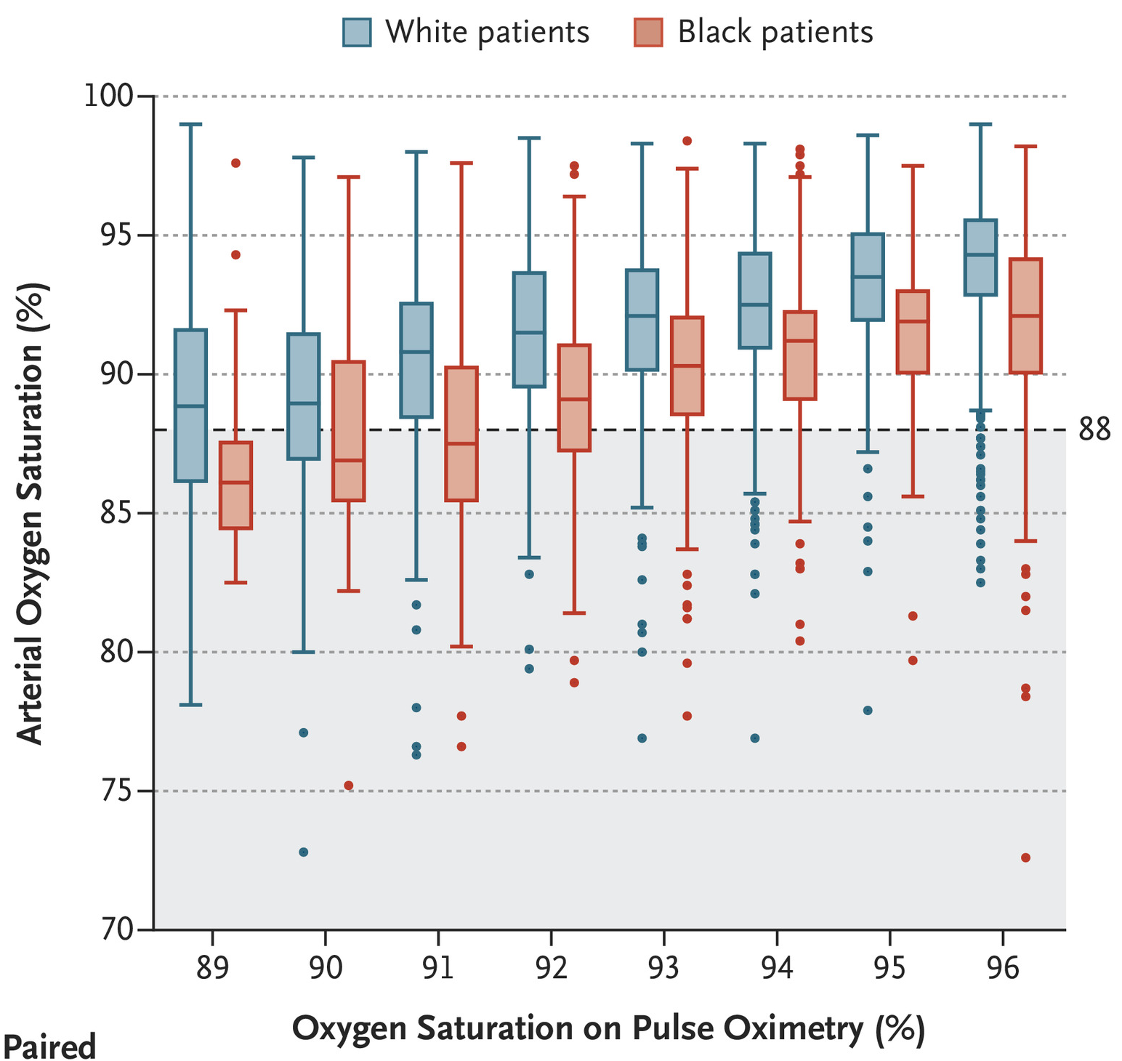

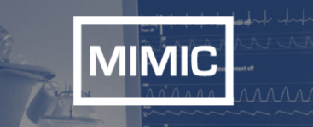
Racial bias in pulse oximetry
Sjoding MW, et al. NEJM. 2020.

Slide 8

More questions within reach
Build on data that already exist
Develop pilot evidence and research programs
Reuse shared knowledge across projects
Notes:
Existing data can also let us develop a question before we commit to a much larger prospective study. They can help us assess feasibility and build preliminary evidence.
There are still costs, approvals, and substantial analytic work. The opportunity is to share that work intelligently. If we make the common foundations available to more teams, more of the campus’s ideas can become studies.

Slide 9
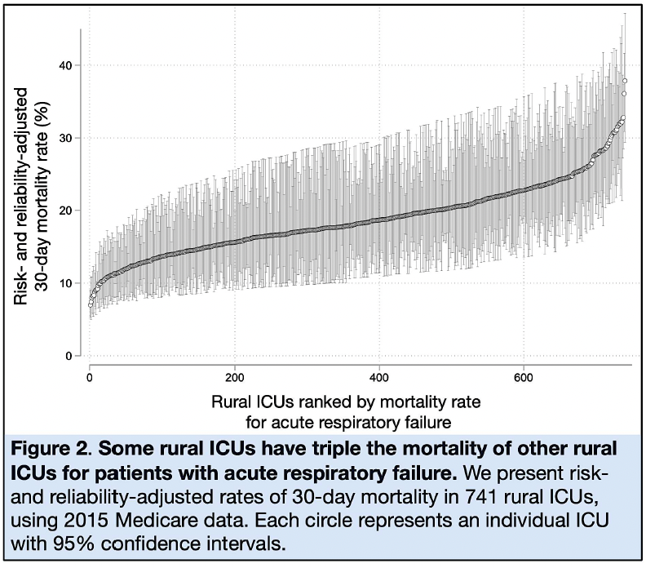
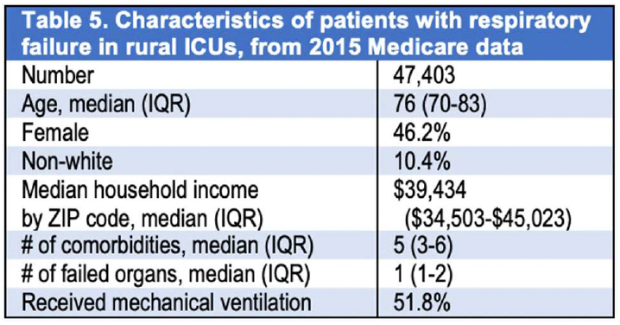
Preliminary data for rural R01 (May 2020)
AHRQ R01 HS028038

Slide 10
Questions that fit claims well
Use of care
Who receives a service, where, and how often?
Care after an encounter
What visits, fills, or admissions follow?
Variation and disparities
How does observed care differ across groups?
Policy and delivery changes
How do use and spending change,
with a credible comparison?
Notes:
Here are some starting points. Who receives a service, and how much does that vary? What happens after an encounter? How do patterns of care differ across places or observable patient groups?
Think about questions from your own field. Follow-up after a hospitalization. Use of a procedure that has become more common. Whether a new service reaches patients across a region. These are examples of questions we could explore, subject to the right data and definitions.
Claims can also support policy evaluation. But the comparison is essential: if something changed after a policy, what else changed at the same time?
For inequities research, we need to establish that the dataset measures the groups we want to compare. Recorded use also does not tell us everything about unmet need.
Take a moment and think of one pattern in care that has made you curious. Perhaps it is something you see repeatedly, or something you suspect varies more than it should. You do not need a complete study design yet. Just keep that question in mind as we go through the next few slides.

Slide 11
What is missing from claims data?
How did the patient feel?
Symptoms, function, and experience
typically need direct data from patients
How sick was the patient?
Physiology and detailed severity
often need clinical records
Why did this happen?
Decisions and barriers may need
interviews or other data
Did the treatment cause it?
A credible design and adequate confounding
control are essential
Notes:
The next step is to ask .
If we want to know whether people felt better, a billed visit is unlikely to be the outcome we really need. If severity at a particular moment drives the question, diagnoses alone may leave an important gap. If we want to understand why someone could not obtain care, we may need to hear directly from them.
This is where the broader strengths of ACCORDS and CU matter. A claims study might identify a pattern that leads to interviews. A registry or electronic health record may add clinical information. A prospective study may be the right way to measure the outcome.
I would like us to treat these conversations as part of developing a good question. Sometimes claims will carry the study. Sometimes they will contribute one essential piece. Sometimes another approach will fit better.
We do not have to force every question into the same dataset. We can use the available methods together to pursue the question that matters.

Slide 12
Secondary data available at CU
Available now
Merative MarketScan
Deidentified claims for commercially insured adults and children across the U.S. from 2015-2024
Linked enrollment, inpatient, outpatient, emergency department, and pharmacy data
Supports studies of healthcare use, medication use, spending, and outcomes
Coming soon
Colorado All-Payer Claims Data
Early 2027
Claims for Coloradans covered by all insurers
Medicare Data
2027 / 2028
National claims on older adults
HCUP Data
2027
National and state encounter data
Notes:
This is the point to connect those possibilities to the resources at CU.
The connection I want to make is between each resource and the questions it puts within reach. For each dataset, who can we study, what can we observe, and what expertise will help us use it well?

Slide 13
An example:
What is the impact of ICU admission on a patient’s spouse?
Population: Spouses of patients admitted to ICU from 2016-2024
Exposure: ICU admission
Comparator: Matched to spouses of 1) non-hospitalized individuals and 2) hospitalized non-ICU patients
Outcome: Primary – all-cause emergency department or acute care hospitalization
Secondary – 1) costs of care and 2) mental health diagnoses
Timing: Over 1 year
Notes:
Here is an example of how the same clinical interest can lead to studies with different requirements.

Slide 14



A place to bring a question
A clinical question
What uncertainty in care
would you like to resolve?
A feasibility conversation
What data and methods would the question need?
A next step
A refined study, a collaboration, or a better-fitting source.
Notes:
You do not need to arrive with every detail resolved. A useful starting point is a question about care that you think deserves an answer.
The Secondary Data Resource Core supports investigators with project development, consultation, and guidance on data and methods. We can use that early conversation to work through feasibility.
It helps to know the population you care about, the outcome that matters, and the decision that better evidence could inform. We can then discuss what data might fit and what expertise the project needs.
Sometimes the next step will be a focused claims study. Sometimes it will be a collaboration with another group, or a recommendation to use another source.
The culture I want to build makes that early conversation easy to have. We can help people develop an idea while it is still taking shape, when there is room to improve the question and choose a strong approach.

Slide 15
The future we can build at CU
Rich evidence
Claims connected with clinical detail
and patient perspectives
Studies that inform interventions and evaluation
Building knowledge
Shared definitions and reusable methods
Teams that can help the next investigator get started
Notes:
Looking ahead, I see an opportunity to connect the breadth of claims with other ways of understanding health. National resources such as SEER-Medicare show the value of combining registry information with claims. The possibilities at CU will depend on the data we have and the linkages we can responsibly build.
But the future is also about how we work together.
Imagine a study that identifies a gap in care. That finding leads to conversations with patients and clinicians about what is happening. Those conversations help shape an intervention. A subsequent study asks whether the intervention reached people and whether outcomes improved.
That is a research program that grows through several methods. Claims can help us see the pattern and evaluate parts of the response. Our colleagues across CU can help us understand and act on it.
Now imagine that each project also leaves something useful for the next team: a tested definition, clearer documentation, an investigator who has learned the data and can mentor someone else.
Over time, the campus gains more capacity to ask and answer important questions. New investigators have more places to begin. Collaborations become easier to form. We can pursue questions that extend beyond the boundaries of our own clinical settings.
That is the ambition: a community that keeps getting better at turning what it sees in care into evidence that can improve care.

Slide 16
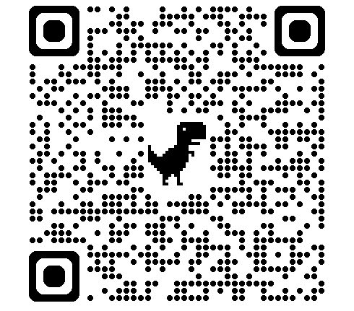
Interested in using secondary data?
Use the QR code to learn more
and initiate a consultation:
Notes:
18:00–20:00
Let me return to that hospital cafeteria.
I met with Colin Cooke at the beginning of fellowship, and one conversation opened up three possible studies. I would like us to create more moments like that at CU.
Somewhere on this campus, a clinician is noticing a pattern that deserves an explanation. A trainee has a question they have not yet figured out how to study. A researcher is wondering whether a change in care is reaching the people it was meant to help.
I want each of them to know where to bring that question, and to find people who will help them work out what comes next.
As Director of the Secondary Data Resource Core, that is the future I want to help build: a campus where shared data and shared expertise make more of our curiosity actionable, and where each study helps the next team begin a little further ahead.
Think back to the question you had in mind a few minutes ago. Bring us that question. Bring the uncertainty you keep returning to, the pattern you cannot quite explain, or the decision you wish had better evidence behind it.
Years from now, I hope someone remembers a first research conversation here at CU the way I remember that meeting with Colin. They arrived with a question. They found people who could help. And they began work that mattered to the patients they hoped to serve.
We can build that kind of place together.

Slide 17
Marketscan Queries; Tales of Secondary Data Use from a Health Outcomes Dummy
Caitlin Bell, MD
Assistant Professor of Medicine
Division of Cardiology, Cardio-Oncology
September 14th, 2026
Notes:
So I want to preface what I’ll present by making it clear that I do not consider myself a health outcomes researcher, I consider myself more of a basic and translational researcher. But Marketscan has been a unique dataset and resource to examine some of the research questions I’m interested in and has been able to generate further testable hypotheses.

Slide 18
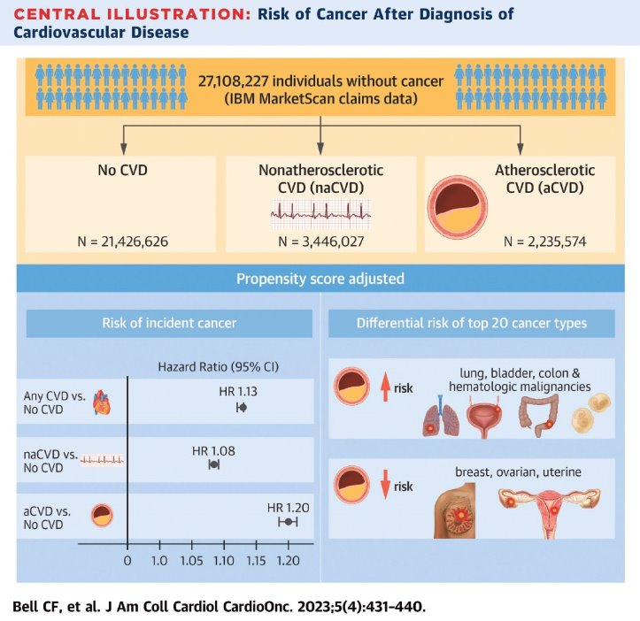
Does CVD lead to increased risk of cancer?
Marketscan wins:
Enormity of dataset allows for common diagnoses.
Usually previously published/accepted ICD-based
definitions for diagnoses.
Marketscan challenges:
Obesity and smoking data are not reliable in the
basic dataset. Need to also have access to a health
research questionnaire database where select patients
self-report these metrics.
Age drop off around retirement.
Notes:
So my first experience with Marketscan was through a project in my postdoc collaborating with the health outcomes group at MD Anderson. Part of what I’m interested in is the biologic crosstalk and shared pathogenesis of cancer and cardiovascular disease. There was also clear data demonstrating that cancer patients and survivors have increased rates of cardiovascular disease. And some more limited suggestion that the inverse was true. So we took Marketscan data of all available individuals with no cancer diagnosis…

Slide 19
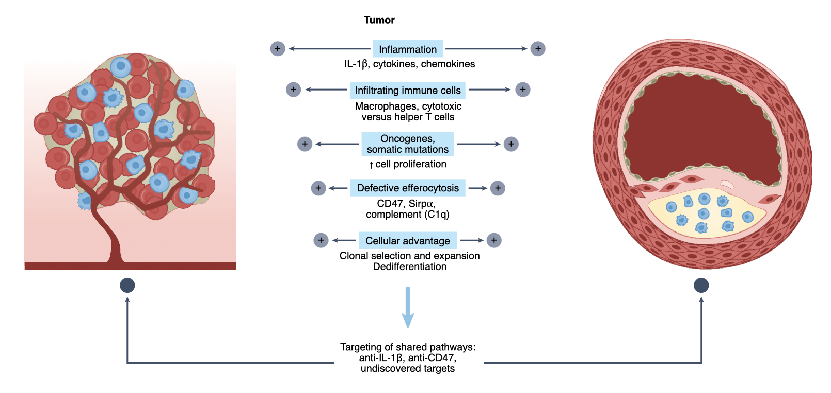
Can common pathways in Cancer and CVD be used for drug repurposing?
Bell and Leeper, Nature Cardiovasc Research. 2022.
Notes:
For this more recent project here at CU, it was partly born out of my interest in thinking about drug repuroposing for these disease entities. Knowing that both in the lab and in human trials there are a lot of shared cellular and signaling processes by each disease, so can you use the same drugs to treat both entities.

Slide 20
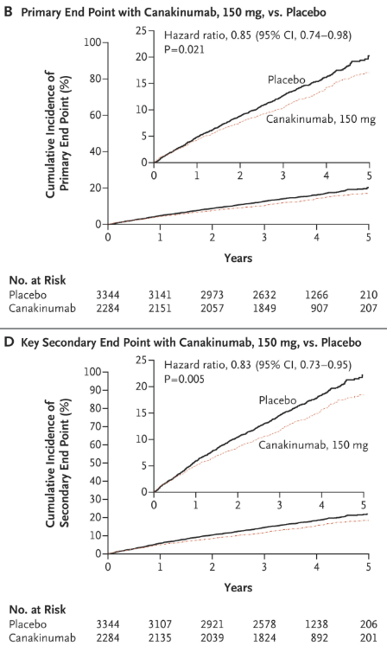
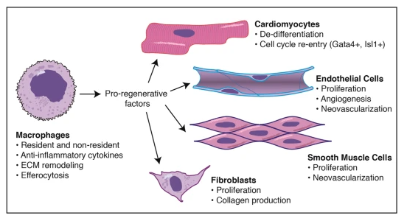
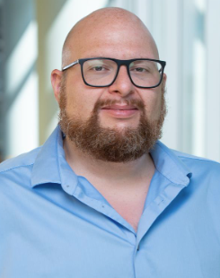
Can Marketscan be used to think about drug repurposing?
Ron Vagnozzi, PhD
CANTOS Trial, NEJM. 2017.
Notes:
And I oft point to the CANTOS trial, which used canakinumab an IL1B inhibitor to treat secondary cardiovascular disease meeting its primary endpoint. It was also shown to decrease rates of lung cancer in this population. But hadn’t gone through because of high infection rates.
So Ron is a cardiac macrophage expert in our division and has a lot of interest in immunomodulatory interventions for cardiovascular disease (CVD) as a growing therapeutic focus area. But they have largely had limited translational impact, as we have now recently seen with the preliminary results of the ZEUS trial.¹ And this is for several reasons. First, understanding of inflammatory pathogenic mechanisms is incomplete.² Second, the multifaceted interplay of innate immune cells, soluble inflammatory mediators, and acute versus chronic inflammation means significant dependence on inflammatory context and time course.³⁻⁵ Third, safety and efficacy profiles for anti-inflammatory agents remain a challenge.
So can we use Marketscan as another way to think about immunomodulatory drug repurposing and targets.

Slide 21
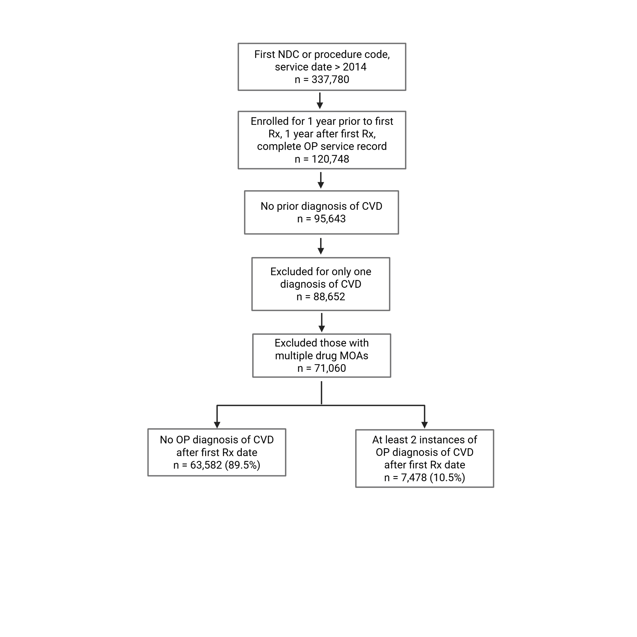
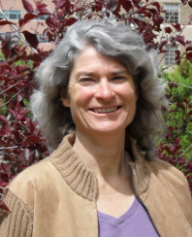
Do different targeted anti-inflammatories confer differential incident CVD risk?
Different targeted anti-inflammatories:
TNFa, IL6, IL17, BAFF, JAK, etc
CVD diagnosis same as prior publication
Sharon Scarbro, MS
Notes:
Can we even use marketscan for this?
If so, really our basic question is whether differently targeted anti-inflammatories confer differential CVD risk?

Slide 22
Do different targeted anti-inflammatories confer differential incident CVD risk?
Characteristic* | Total (N=71060) | TNFa (N=44102) | BAFF (N=1875) | CD80 (N=2817) | IL-17a (N=3066) | IL-23 (N=8230) | IL6 (N=698) | Integrin (N=6136) | JAK (N=4136)
Demographics
Age, years, Median (IQR) | 45 (34, 54) | 44 (33, 54) | 42 (33, 50) | 53 (44, 58) | 47 (38, 55) | 44 (34, 53) | 50 (39, 58) | 42 (33, 50) | 51 (42, 57)
Male sex | 27789 (39.1%) | 18033 (40.9%) | 105 (5.6%) | 450 (16.0%) | 1670 (54.5%) | 4277 (52.0%) | 126 (18.1%) | 2198 (35.8%) | 930 (22.5%)
Comorbidities
Diabetes | 10321 (14.5%) | 6201 (14.1%) | 260 (13.9%) | 561 (19.9%) | 627 (20.5%) | 1294 (15.7%) | 126 (18.1%) | 608 (9.9%) | 644 (15.6%)
Hypertension | 27155 (38.2%) | 16363 (37.1%) | 908 (48.4%) | 1409 (50.0%) | 1459 (47.6%) | 3021 (36.7%) | 350 (50.1%) | 1767 (28.8%) | 1878 (45.4%)
Chronic kidney disease | 2589 (3.6%) | 1510 (3.4%) | 240 (12.8%) | 135 (4.8%) | 79 (2.6%) | 209 (2.5%) | 51 (7.3%) | 192 (3.1%) | 173 (4.2%)
Hyperlipidemia | 30621 (43.1%) | 18366 (41.6%) | 722 (38.5%) | 1462 (51.9%) | 1658 (54.1%) | 3752 (45.6%) | 390 (55.9%) | 2067 (33.7%) | 2204 (53.3%)
Indication for anti-inflammatory therapy**
Rheumatoid arthritis | 23472 (33.0%) | 15870 (36.0%) | 606 (32.3%) | 2627 (93.3%) | 196 (6.4%) | 217 (2.6%) | 630 (90.3%) | 118 (1.9%) | 3208 (77.6%)
Psoriatic arthritis, psoriasis | 21640 (30.5%) | 10869 (24.6%) | 43 (2.3%) | 191 (6.8%) | 2992 (97.6%) | 6899 (83.8%) | 32 (4.6%) | 142 (2.3%) | 472 (11.4%)
Ankylosing spondylitis | 5193 (7.3%) | 4634 (10.5%) | 52 (2.8%) | 86 (3.1%) | 83 (2.7%) | 77 (0.9%) | 22 (3.2%) | 83 (1.4%) | 156 (3.8%)
Juvenile idiopathic arthritis | 1418 (2.0%) | 1030 (2.3%) | 9 (0.5%) | 120 (4.3%) | 3 (0.1%) | 14 (0.2%) | 78 (11.2%) | 8 (0.1%) | 156 (3.8%)
Ulcerative colitis | 10124 (14.2%) | 7242 (16.4%) | 13 (0.7%) | 10 (0.4%) | 19 (0.6%) | 578 (7.0%) | 7 (1.0%) | 2062 (33.6%) | 193 (4.7%)
Crohn cisease | 14684 (20.7%) | 11685 (26.5%) | 16 (0.9%) | 13 (0.5%) | 9 (0.3%) | 1235 (15.0%) | 3 (0.4%) | 1668 (27.2%) | 55 (1.3%)
Lupus | 3215 (4.5%) | 773 (1.8%) | 1853 (98.8%) | 244 (8.7%) | 32 (1.0%) | 52 (0.6%) | 33 (4.7%) | 25 (0.4%) | 203 (4.9%)
Baseline Characteristics of Patients Initiating Anti-Inflammatory Therapy by Mechanism of Action

Slide 23
Time to Follow-up and Cardiovascular Outcomes by MOA
 | Total (N=71060) | TNFa (N=44102) | BAFF (N=1875) | CD80 (N=2817) | IL-17a (N=3066) | IL-23 (N=8230) | IL6 (N=698) | Integrin (N=6136) | JAK (N=4136)
Median follow-up, years, (IQR) | 2.3 (1.5, 3.9) | 2.6 (1.6, 4.0) | 2.2 (1.3, 3.9) | 2.3 (1.5, 4.1) | 2.2 (1.4, 3.1) | 1.9 (1.4, 2.4) | 2.2 (1.4, 3.9) | 2.8 (1.7, 4.7) | 2.2 (1.4, 3.7)
Outcome during follow-up
No CVD | 63582 (89.5%) | 39681 (90.0%) | 1454 (77.5%) | 2207 (78.3%) | 2771 (90.4%) | 7816 (95.0%) | 545 (78.1%) | 5519 (89.9%) | 3589 (86.8%)
Incident CVD | 7478 (10.5%) | 4421 (10.0%) | 421 (22.5%) | 610 (21.7%) | 295 (9.6%) | 414 (5.0%) | 153 (21.9%) | 617 (10.1%) | 547 (13.2%)
aCVD* | 4048 (5.7%) | 2375 (5.4%) | 199 (10.6%) | 362 (12.9%) | 174 (5.7%) | 217 (2.6%) | 89 (12.8%) | 313 (5.1%) | 319 (7.7%)
naCVD | 3430 (4.8%) | 2046 (4.6%) | 222 (11.8%) | 248 (8.8%) | 121 (3.9%) | 197 (2.4%) | 64 (9.2%) | 304 (5.0%) | 228 (5.5%)
Abbreviations: CVD: cardiovascular disease. aCVD: Atherosclerotic CVD. naCVD: Non-atherosclerotic CVD.
Values are in n (%) unless otherwise specified. Percentages are based on the total number of individuals within each MOA category.
*aCVD and naCVD are subcategories of Incident CVD. Those individuals with both aCVD and naCVD were classified as atherosclerotic

Slide 24
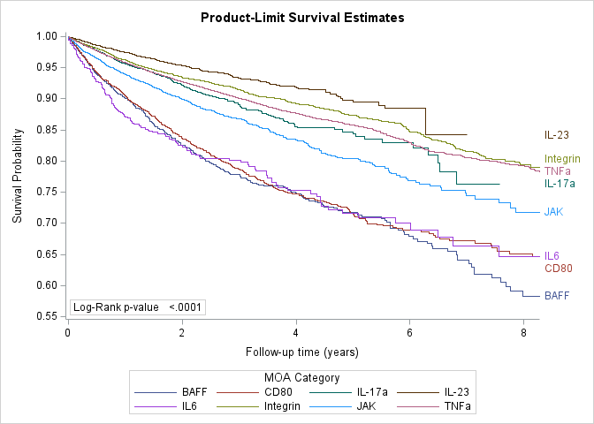
Time to Follow-up and Cardiovascular Outcomes by MOA
Notes:
Ultimately we decided to use the TNFa group as our reference condition. There is outcomes data suggesting its use actually lowers cv events in the rheumatologic population, and it’s often the first line biologic medication used in this disease population. Other health services papers have previously used it as a reference population as well when looking at cv outcomes on anti-inflammatories.

Slide 25
MV Cox PH modeling results
Inhibitor MOA | HR (95% CI) | P value
BAFF | 2.38 (2.15, 2.36) | <0.0001
IL-6 | 1.86 (1.58, 2.19) | <0.0001
CD80 | 1.61 (1.48, 1.76) | <0.0001
JAK | 1.1 (1.01, 1.21) | 0.0340
Integrin | 1.03 (0.94, 1.12) | 0.5351
IL-17a | 0.93 (0.85, 1.05) | 0.2511
IL-23 | 0.64 (0.58, 0.71) | <0.0001
***TNFa inhibitors are the reference group.
Notes:
Not able to control for obesity and smoking. But did control for demographics, hypertension, hyperlipidemia, diabetes, CKD.

Slide 26
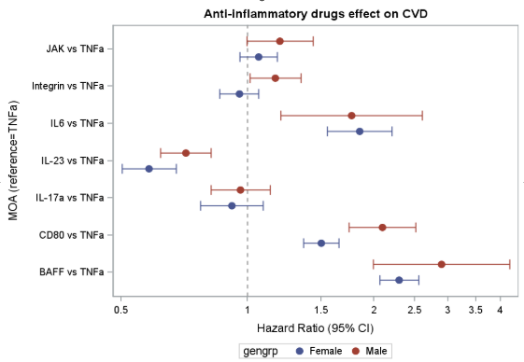
Is risk dependent on sex?
Notes:
And something that struck us in our overall cohort was that the rate of CVD in men was slightly lower than in women, 9 vs 11%, which is unusual for the pre/perimenopausal lifespan. So We tested whether there were any significant interactions between drug MOA and sex. And the only interaction again using TNFa as the reference was that males on CD80 had a significantly increased risk compared to females on CD80 for CVD. No other MOAs seemed ot have this interaction with sex.

Slide 27
Conclusions thus far….
Different MOAs do appear to confer different risk of incident cardiovascular disease, some enhancing and some protective.
Some of this appears dependent on sex, but mostly not.
This is the first example to our knowledge of using Marketscan in this way to more broadly consider CVD trends in the setting of immunomodulatories with an eye toward drug repurposing/biologic insight.
We do feel this was very successful from the perspective of further hypothesis generation to be tested in other ways.

Slide 28

Limitations Thank you!
Sharon Scarboro, MS
Ron Vagnozzi, PhD
Larry Allen, MD
There are a myriad of limitations to this analysis:
The populations on different MOAs might inherently be higher risk for CVD by metrics we can’t measure.
Several assumptions are made when using TNFa as the reference group.
This is overall a younger population, relatively short median follow up.
We couldn’t account for obesity and smoking.
We didn’t layer in use vs non-use of other drugs (like statins or aspirin).

Slide 29
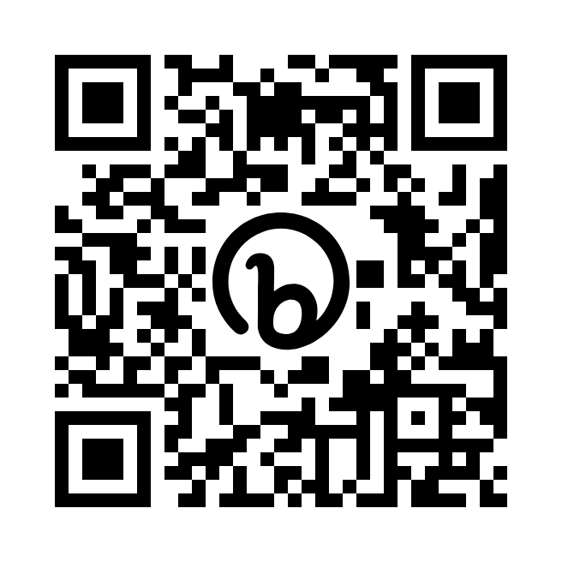
Upcoming ACCORDS Education Program Events
September 14, 2026 Krugman Conf Hall RC2 2100 | ACCORDS Highlights Use of Secondary Data to Advance Health Outcomes Presented by: Tom Valley, MD, MSc and Caitlin Bell, MD
September 23, 2026 Elliman Conf Ctr, AHSB | Health Services Research Day Join colleagues across Medicine, Nursing, Pharmacy, Dentistry, Public Health, Veterans Affairs, Denver Health, Kaiser, and beyond to explore how health services research is shaping the future of healthcare.
October 19, 2026 Krugman Conf Hall RC2 2100 | ACCORDS Grand Rounds
October 28, 2026 virtual | ACCORDS & CCTSI Community Engagement Forum Building and Maintaining Healthy Community-Academic Partnerships Connect with community and academic partners!
Annual Conference May 25-27, 2027 9-4pm MT | Colorado Pragmatic Research in Health Conference Visit COPRHcon.com for more information!
https://bit.ly/ACCORDSEdu

